Slide 1
Chapter 24: Individual Responsibility
Part II
Francisco H. G. Ferreira* and Vito Peragine#
*The World Bank and IZA
# University of Bari
Oxford Handbook of Well-Being and Public Policy Workshop
Princeton University, March 1st, 2014

Slide 2
Section 5: Empirical applications
All known empirical applications of the measurement of inequality of opportunity follow the indirect approach.
Some are based on norm-based approaches in the spirit of the direct unfairness and fairness gap matrices
  e.g. Almas et al. (2011); Devooght (2008)
There are also examples of within-tranches inequality applications.
  e.g. Checchi and Peragine (2010)

Slide 3
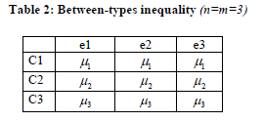


But the between-types inequality version of the indirect approach has been used most often.
$$IEOR=\frac{I{(\tilde{x}}_{BT})}{I\left(x\right)}$$
Simply compute:
$$IEOL=I{(\tilde{x}}_{BT})$$

Slide 4
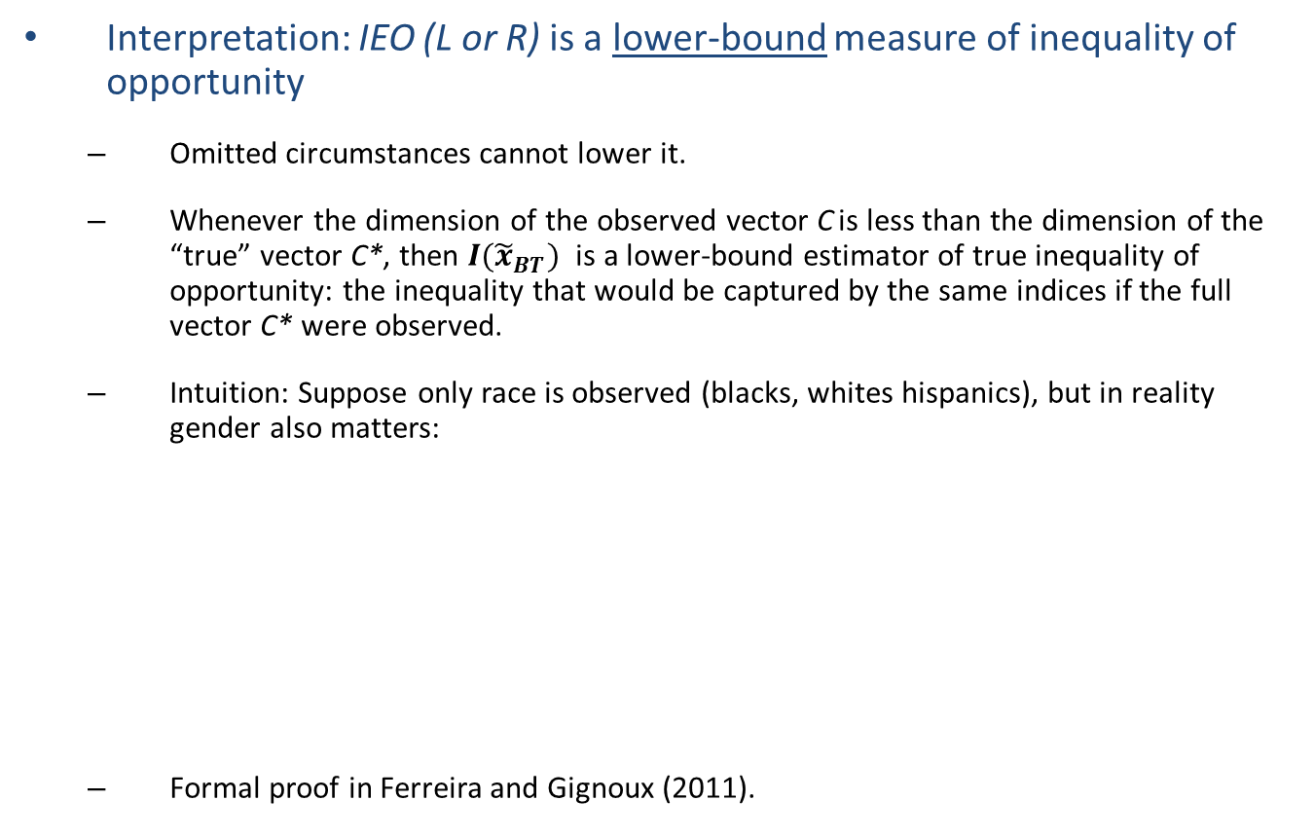
Caveat 1: A lower bound estimate
Interpretation: IEO (L or R) is a lower-bound measure of inequality of opportunity
  Omitted circumstances cannot lower it.
  Whenever the dimension of the observed vector C is less than the dimension of the “true” vector C*, then $I{(\tilde{x}}_{BT})$ is a lower-bound estimator of true inequality of opportunity: the inequality that would be captured by the same indices if the full vector C* were observed.
  Intuition: Suppose only race is observed (blacks, whites hispanics), but in reality gender also matters:
  Formal proof in Ferreira and Gignoux (2011).

Slide 5
Caveat 1: A lower bound estimate
Interpretation: IEO (L or R) is a lower-bound measure of inequality of opportunity
  Omitted circumstances cannot lower it.
  Whenever the dimension of the observed vector C is less than the dimension of the “true” vector C*, then $I{(\tilde{x}}_{BT})$ is a lower-bound estimator of true inequality of opportunity: the inequality that would be captured by the same indices if the full vector C* were observed.
  Intuition: Suppose only race is observed (blacks, whites hispanics), but in reality gender also matters:
  Formal proof in Ferreira and Gignoux (2011).

Slide 6
Caveat 2: Parametric estimates
When the information on circumstances is rich enough, the number of types may become too large to estimate either IEO non-parametrically.
Follow Bourguignon et al. (2007) and Ferreira and Gignoux (2011) in proposing a simple model:
For the purpose of simply measuring inequality of opportunity, it suffices to estimate the reduced form:
Say, by OLS:
Can then compute “parametrically smoothed distribution”:
Leading to the parametric estimate:

Slide 7
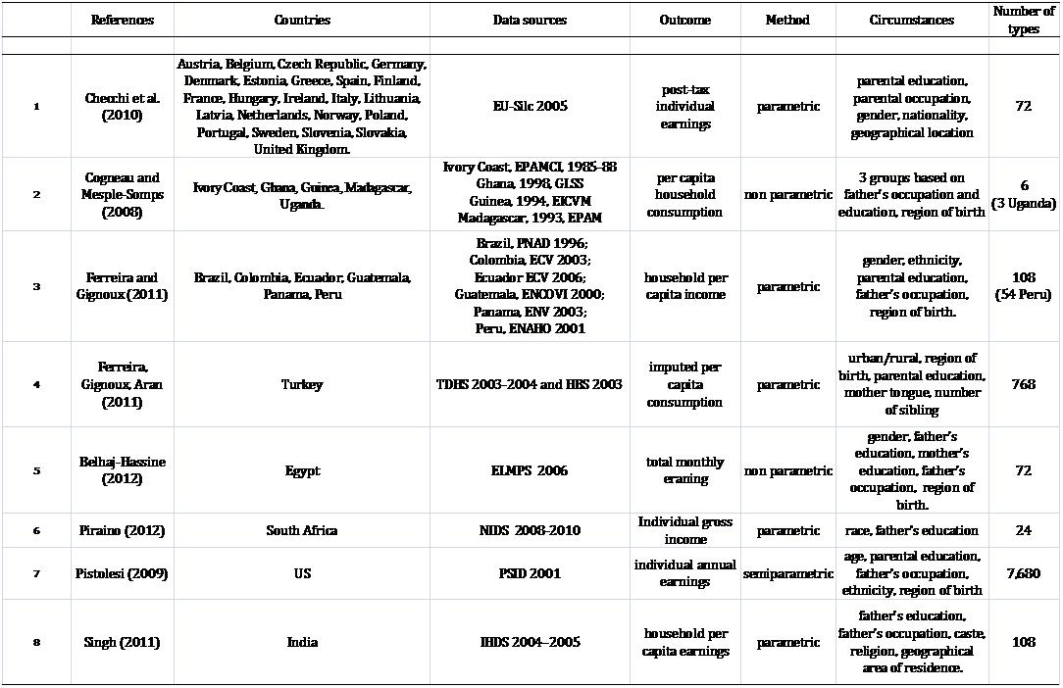
Eight case studies

Slide 8
Forty-one country estimates
Note: Estimates come from different studies and are not strictly comparable.
Source: Brunori et al. (2013)

Slide 9
Some correlations (i)
Note: Estimates come from different studies and are not strictly comparable.
Source: Brunori et al. (2013)

Slide 10
Some correlations (ii)
Note: Estimates come from different studies and are not strictly comparable.
Source: Brunori et al. (2013)

Slide 11
Section 6. Implications for poverty and development
“The rate of economic development should be taken to be the rate at which the mean advantage level of the worst-off types grows over time. […] I look forward to a future number of the WDR that carries out the computation, across countries, of this new definition of economic development” (p.243).
Roemer, John E. (2006): “Review Essay, ‘The 2006 world development report: Equity and development”, Journal of Economic Inequality (4): 233-244
Define an opportunity profile:
And an opportunity-deprivation profile:

Slide 12
Opportunity-deprivation profiles
The Brazilian profile, by income per capita
Brazil’s “opportunity-deprivation profile” in 1996: six poorest “social types” (adding up to 10% of the population), defined by pre-determined background characteristics.

Slide 13

Opportunity-sensitive poverty measurement
Should there be a poverty measure that is sensitive to I. Op., in the same way as FGT(2) or the Sen Index are sensitive to outcome inequality?
  Brunori, Ferreira, Lugo and Peragine (2013)
  Anonymity axiom restricted to within types
  Transfer axiom replaced by separate inequality aversion axioms within and across types.
  Tension between IOA and IAW is resolved by introducing a hierarchy:

Slide 14
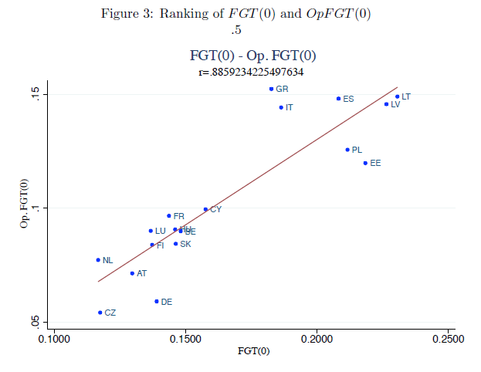
Opportunity-sensitive poverty measurement
Poverty levels across eighteen European countries: standard headcount against opportunity-sensitive headcount

Slide 15
The development objective
The measurement distinction between the ex-ante and ex-post approaches is related to the conceptual distinction between the “equal opportunity policies” of Roemer and van de Gaer:
  Roemer’s “Mean of mins”
  Van de Gaer’s “Min of Means”

Slide 16
The development objective
What is the policy objective for opportunity egalitarians?
The choice of policies from a feasible set so as to maximize the future stream of ‘advantage’ for the most disadvantaged type, subject to a no-deprivation constraint and to a feasibility constraint.
Source: Bourguignon, Ferreira and Walton, JEI 2007.

Slide 17
The development objective
‘Deconstructing’ the equitable development policy problem:
“Growth matters”
Permissible Policy Set:
Technical feasibility and social acceptability
Poverty eradication as a ‘constraint’.
“Rawlsian” criterion. All weight on the least advantaged.
Source: Bourguignon, Ferreira and Walton, JEI 2007.

Slide 18
And finally…
The empirical literature on I. Op. is now moving beyond measurement, to the exploration of causal relationships:
  With economic growth (e.g. Marrero and Rodriguez, JDE, 2013)
  With public policy (van de Gaer et al., WBER forthcoming)
Measurement challenges still plague these new applications…
…but the empirical examples have led to inroads in the dialogue with policy makers.

