Slide 1
Hedonic Approaches
Dan Haybron Saint Louis University

Slide 2
“Hedonic” views of WB?
“Hedonic”: pertaining to pleasure and unpleasure
Only hedonistic theories (Bentham…) clearly “hedonic”
A family of theories centering on “evaluative mental states”
  Pleasure
  Life satisfaction
  Emotional well-being
Some of these aren’t strictly mental state theories
Strictly, concerned with “evaluative mental-state-centered” theories of WB

Slide 3
The allures of hedonism
Focus on pleasantness of experience, esp suffering
Three basic attractions
  If anything matters for WB, pleasure seems to
  A simple, unified account that explains a lot
  The “phenomenological intuition”: pleasure seems to matter b/c of what it’s like
    Hard to explain this in a nonhedonistic framework
A deep challenge for theories of WB: give a plausible, principled completion of the schema “pleasure matters because of what it is like, x matters because of y…”

Slide 4
Objections to hedonism
Deception (experience machine)
Impoverishment (scratcher)
Deprivation (blindness, syndrome X)
Degradation (pig’s life, humiliation, servility…)
Inauthenticity (closeted gays, soma, lobotomy)
The shape of a life (uphill vs. downhill)
Chief question: how much weight to give these intuitions?

Slide 5

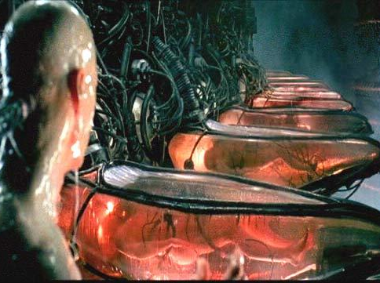
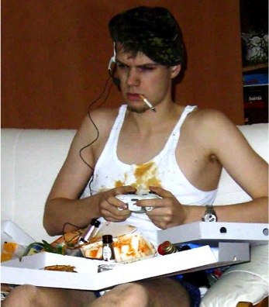
Deprivation, deception, impoverishment

Slide 6
Life satisfaction
Core of LS is a judgment that your life is going well enough for you
  Not a “hedonic” view, but an alternative to such views
By itself, LS not obviously important except as an indicator of WB (e.g., preference satisfaction)
LS forms the core of Sumner’s “authentic happiness” theory of WB
  WB = authentic happiness
  Authenticity = informed and autonomous
  Seems at least to deal with deception and inauthenticity intuitions

Slide 7
Objections to LS views
Chief worry: is LS appropriately related to WB?
  Global judgment: a coin toss how to sum your life in a single number
  Satisfaction: LS not about whether doing well—whether doing well enough
Upshot: you might be satisfied though you feel bad and think your life is going badly for you
  Why satisfied? “One day is good and the other one is bad, whoever accepts the least lives.”
Less of a problem for LS measures than LS views of WB: higher LS may still tend to signal higher WB (e.g., WHR)
  Can take the “satisfaction” out of LS, as in the Cantril ladder measure
  Can focus on univalent measures to focus attention on relative vs. absolute WB
Still, biases—e.g., salience biases and positivity biases—are a problem
  LS may be mainly a gauge of success re. chronically salient values
  Does Mexico score higher than Germany b/c of positivity biases?

Slide 8
Emotional well-being
Oddly, affect measures tend to omit an obvious hedonic concern: pain!
Perhaps because not trying to assess pleasantness of experience, but emotional condition: EWB
Are people depressed, anxious, stressed, or cheerful, energetic and relaxed?
EWB may be partly unconscious or dispositional: e.g., “are you able to enjoy activities?”
  Grieving: may be emotionally fragile, hence lower in EWB, even when in a good mood

Slide 9
Emotional well-being: issues
Why care about EWB, vs. HB?
Why care about depression versus chronic pain?
Some possibilities?
  Perhaps WB consists partly in authentic happiness, where happiness = EWB (as part of a self-fulfillment view of WB)
  EWB seems to serve as a general evaluation of the person’s life conditions (depression vs. pain)
  EWB may play a central causal role in WB generally. Perhaps more predictive of health, success…
  EWB might be an efficient indicator of HB
Problems for EWB-based theory of WB: embedding in teleological “self-fulfillment” framework arouses skeptical doubts

Slide 10
“Subjectivist”?
The most compelling interpretation of “subjectivism” ties it to the agent’s judgment about her best interests (agent sovereignty)
  “Who are you to say what’s best for me?”
LS seems subjectivist in this sense, but not hedonism!
Hedonism is only subjectivist in a different sense: it concerns the quality of conscious experience
  Reflective vs. phenomenal subjectivity
  Not clear why this is so compelling
SWB straddles both kinds of subjectivity: not clearly subjectivist in any interesting univocal sense
  Both LS and affect components involve evaluations by the “subject”, but not clear how this grounds an objection to objectivism

Slide 11
Do theories of WB matter for policy?
Not clear it matters for policy which theory of WB is right
Perhaps policymakers must defer to citizens’ own views of WB when making policy on their behalf: hedonistic for hedonists, Aristotelian for Aristotelians…
  “Pragmatic subjectivism” (Haybron and Tiberius)
  Happy moral: lack of philosophical consensus on WB needn’t hamstring WB policy
Common intuitions about deception, impoverishment, etc. may merit policy attention even if best theory of WB flouts them: if people care about deprivation, may not be entitled to ignore that fact

Slide 12
Measures of WB for policy
Whatever the right account of WB for policy, likely need indicators corresponding to all 3 mental state approaches to WB, b/c all offer important information
  For the same reason, even hedonists will want metrics of health, education, etc., b/c all measures have shortcomings
GE: general evaluations
  EWB (emotional well-being). My bet for “most informative” if reliable
  LE (life evaluation): E.g., modified Cantril scale
EQ: experiential quality (e.g., in time use studies). E.g.,
  HB: hedonic balance (pleasure/suffering)

Slide 13
“Happiness” policy?
Bhutan’s GNH uses ‘happiness’ for WB, encompassing whatever matters for welfare
In more common psychological usage, theories of H identify it variously with: pleasure, LS, or EWB
Warning: no consensus on right theory of H, and very different import of each. Use term with caution, or use other terms
Especially important to limit claims about who is “happy” or not: we don’t know how to justify them
  If “happy” means “satisfied,” then not important (Egyptians)
  If “happy” refers to HB or EWB: we don’t know threshold. But it has to be >1:1 ratio of positive to negative affect (“life barely worth living”)

Slide 14

Thank you!

Slide 15
How do we tell which theory is right?
E.g., why care about intuitions about experience machines etc.?
At least two basic options: Plato and Hume
A Humean grounds values in human valuing—our sensibilities, say. The right values depend on us
  E.g., what we’d say on reflection
A good theory should (on this view) fit with our sensibilities
Intuitions might be evidence of fit, or lack thereof
Need be nothing occult about any of this

Slide 16
Strengths and limitations of LS measures

Slide 17
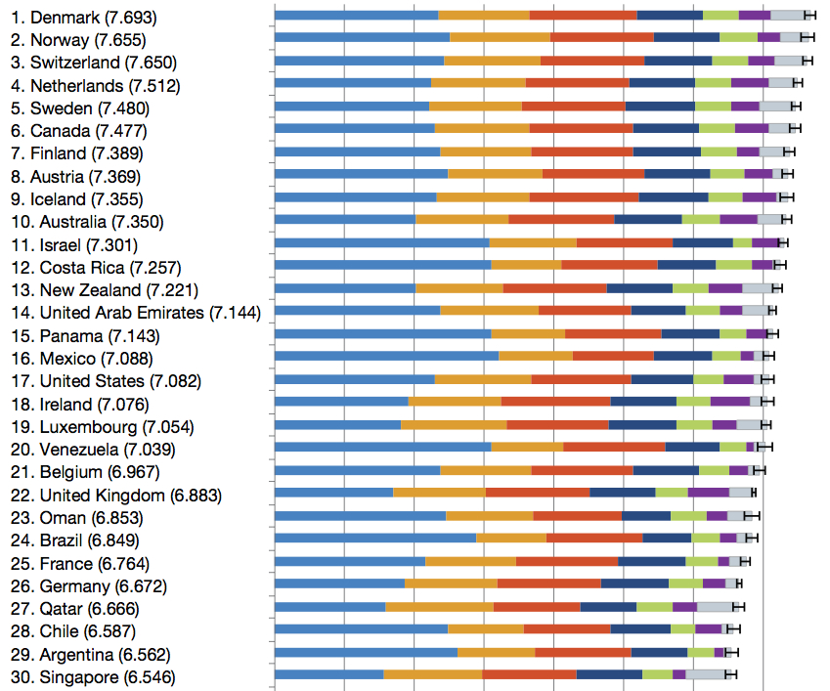
Ladder top 30 2010-12 (WHR)

Slide 18
The chief sources of happiness: SOARS
Security (material, social, time…)
Outlook (positivity, acceptance, caring…)
Autonomy
Relationships
Skilled and meaningful activity

